Slide 1
Coaching Update
29 October 2019
Holiday Inn, Harare

Slide 2
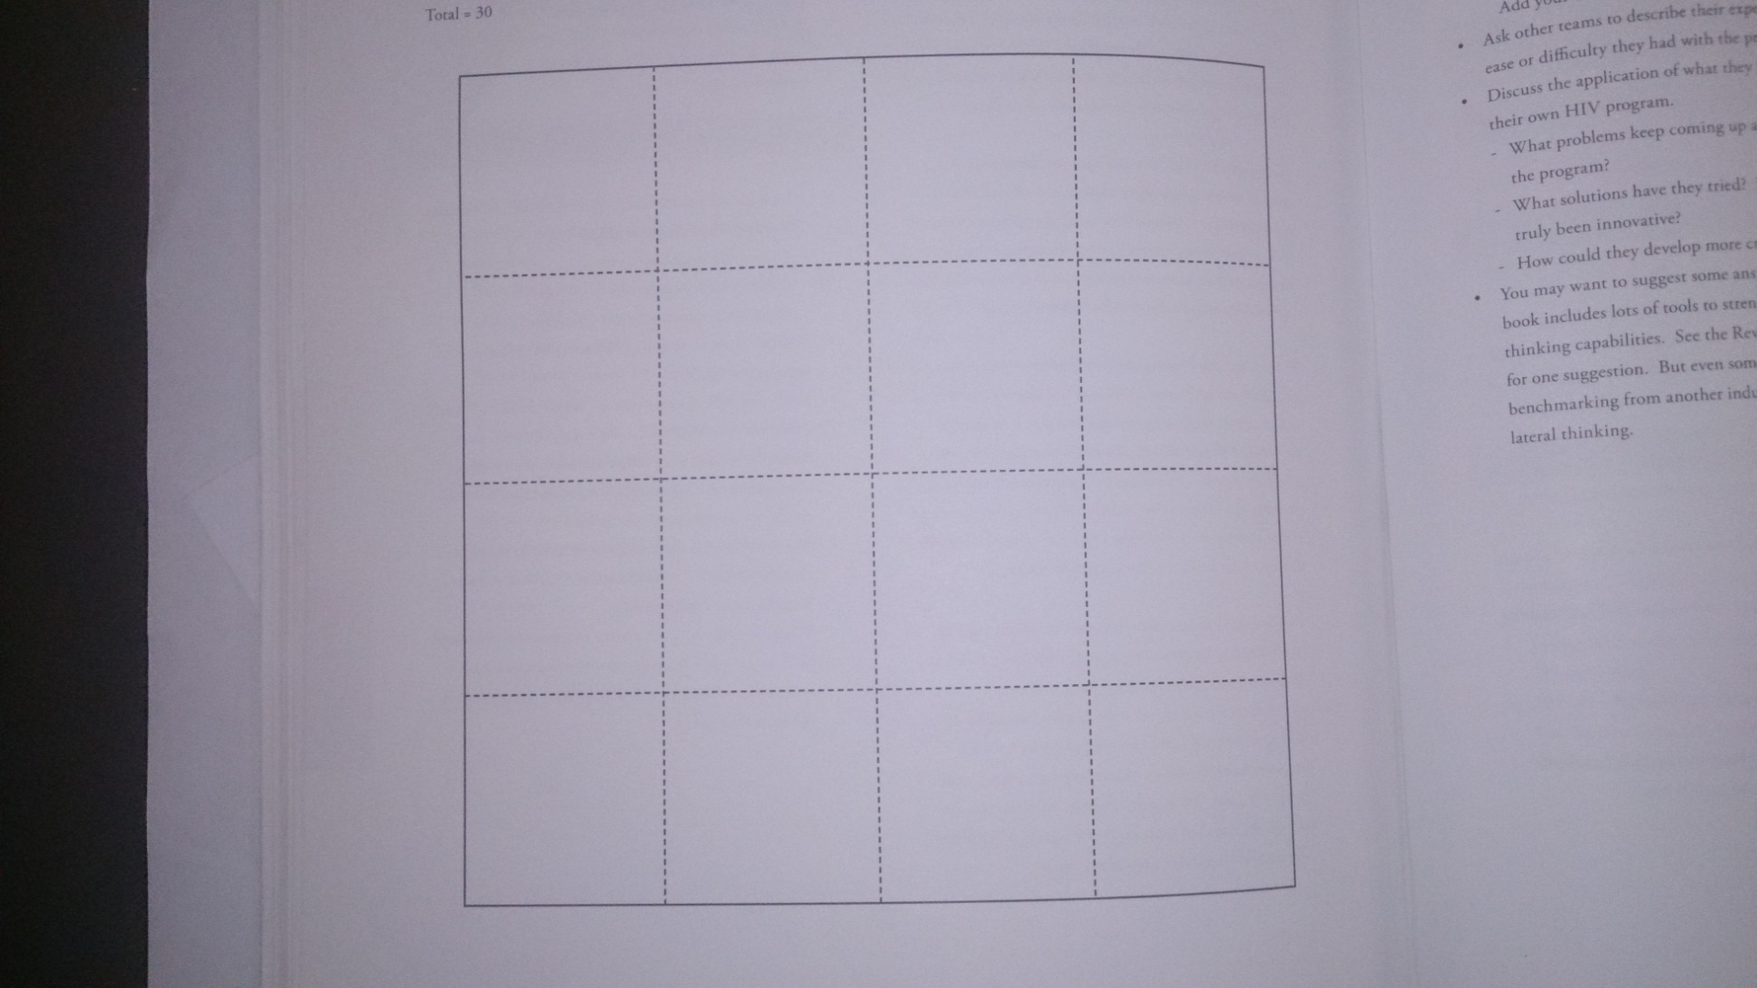

Slide 3
Definition of Terms
Coaching is…
"a process that enables learning and development to occur and thus performance to improve. To be a successful coach requires a knowledge and understanding of process as well as the variety of styles, skills and techniques that are appropriate to the context in which the coaching takes place“
Eric Parsloe, The Manager as Coach and Mentor (1999) page 8. Eric is a respected author and Director of the Oxford School of Coaching and Mentoring
Notes:
Today’s training is a beginning in skill development.

Slide 4
An analogy….
What does the coach do for the athlete?

Slide 5
An analogy….
The athlete decides the goal, the coach helps him get there.
The coach assesses strengths and weaknesses honestly and gives feedback.
The coach encourages and pushes, but does not DO exercises for the athlete.
The coach helps the athlete keep focused on the goal and moving forward.
The coach brings technical information about how to achieve the goal.

Slide 6

Coaching Behaviors
Support by setting appropriate goals and methods of assessing progress in relation to these goals – Follow up using previous visit results
Goal | Actions | Timeline

Slide 7
Expectations from VL CLI coaches
Conduct coaching site visits with site QI teams and assist them with implementing continuous improvement efforts, including the tools, workshop PPT reports and the deliverables
  help site teams understand and use their performance measurement data to improve
Conduct CMM and develop recommendations for improvement
Guide site teams to document QI activities
Support data collection activities, including validating raw data
With faculty, plan and facilitate VL CLI rollout to new facilities, and build capacity of new coaches as the VL CLI rolls out

Slide 8
Coaching tasks
On-site visit at least once a month
  Review performance from past month past month, incl whether agreed PDSAs were implemented
  Identify new gaps
  Identify new opportunities for improvement
  Documentation of PDSAs
  DQA on VL CLI metrics
Virtual support in-between monthly visits
Monthly Coach meetings (virtual and physical) with PMT
Virtual calls with LARC team
Facilitate peer learning among participating facilities between LSs
Rapidly escalate system issues requiring MOHCC attention e.g. S/O of registers

Slide 9
Coaching process indicators
Measured on a monthly basis, and reviewed by Collaborative project management team.
Process indicators will be calculated to confirm adherence to Collaborative methodology.
What we want to know:
  Were the Collaborative sites visited?
  Were sites’ Collaborative data reviewed during the visit?
  Were sites’ PDSAs documented?
  Were sites’ CMM scores captured Pre & Post LARC?

Slide 10
Documentation for QI- QI Coaches
Deliverable | Frequency
VL CLI activity summary- one pager | Monthly
VL CLI Facility Data submitted (after meeting with facility team) | Monthly
Viral Load Cascades | Quarterly
VLI coaching summary | After every coaching visit
Success stories (narrative reports as well as QI story boards ) | At least one per quarter

Slide 11
Thank you

